Slide 1
Lesson 8
Wǒ xiǎng hē chá.

Slide 2
Text 1 : In a restaurant
A: Nǐ xiǎng hē shén me ？
B: Wǒ xiǎng hē chá.
A: Nǐ xiǎng chī shén me ？
B: Wǒ xiǎng chī mǐ fàn.
want,
would like
drink
tea
eat
rice

Slide 3
Text 2 : In the living room
A: Xià wǔ nǐ xiǎng zuò shén me ？
B: Xià wǔ wǒ xiǎng qù shāng diàn.
A: Nǐ xiǎng mǎi shén me ？
B: Wǒ xiǎng mǎi yī gè bēi zi.
shop, store
buy
cup, glass

Slide 4
Money

Slide 5
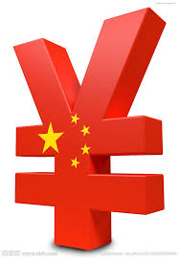
Name Of Chinese Currency Rén Mín Bì
RMB
yuán
1 RMB = 16 PKR

Slide 6
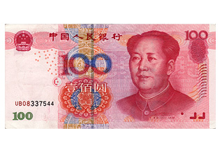
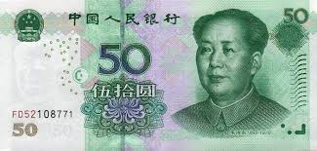
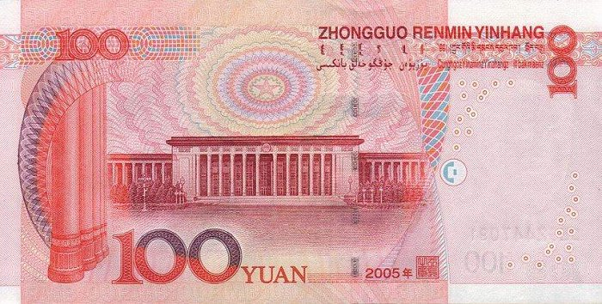
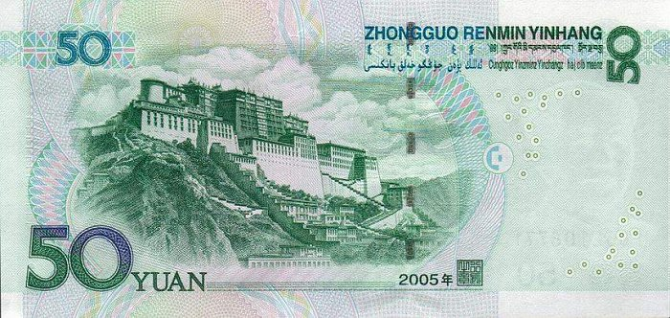
¥ 100
¥ 50

Slide 7
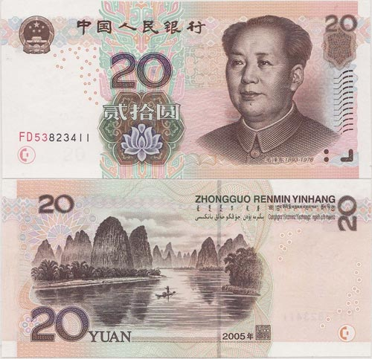
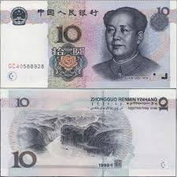
¥ 20
¥ 10

Slide 8
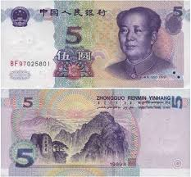
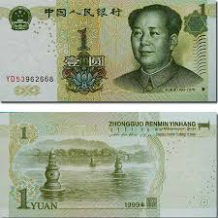
¥ 5
¥ 1

Slide 9
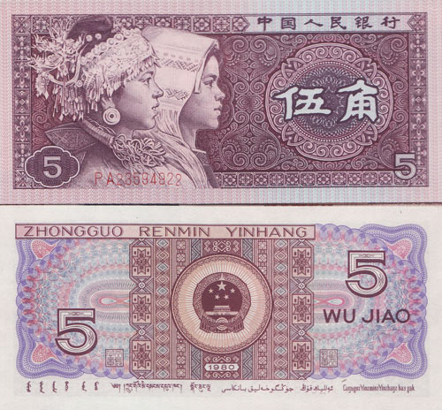
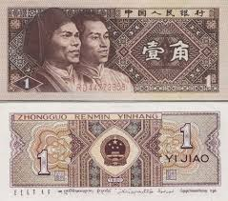
¥ 0.5
¥ 0.1

Slide 10
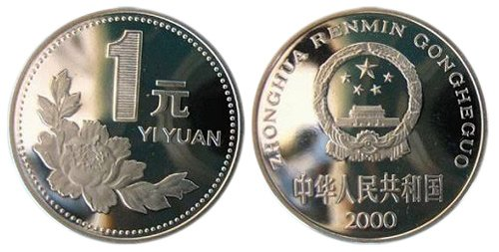
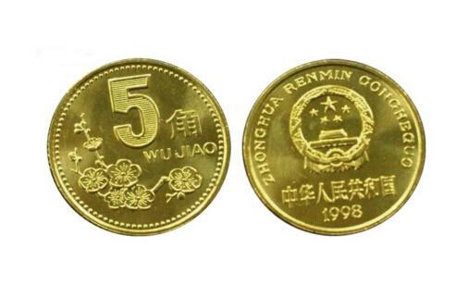

¥1
¥ 0.5
¥ 0.1

Slide 11
Text3 : In a store.
A: Nǐ hǎo ! Zhè gè bēi zi duō shǎo qián ？
B: 28 kuài.
A: Nà gè bēi zi duō shǎo qián ？
B: Nà gè bēi zi 18 kuài (qián).
how much
money
yuan
that

